Slide 1

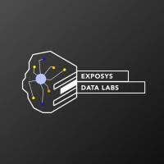
EXPOSYS DATA LABS
INTERNSHIP
WEB DEVELOPMENT
PROJECT REPORT ON:
‘EXPENSE TRACKER’
Project by:
Name: Kiran Chandmal Kankariya
College: Pune Institute Of Computer Technology

Slide 2

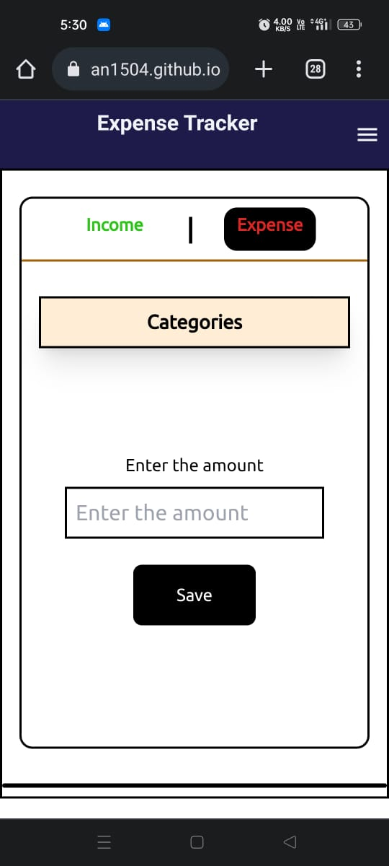
EXPENSE TRACKER: To track all your daily expenses.
Welcome to Expense Tracker Website. This website is beneficial for tracking down all your expenses and managing your finance.

Slide 3
Abstract
In today's fast-paced world, managing personal finances efficiently is crucial for individuals to achieve financial where adjustments can be made to achieve financial wellness. stability and meet their long-term goals. To facilitate this process, the advent of expense tracking applications has revolutionized the way people monitor and control their expenses. This abstract highlights the significance of expense trackers, their key features, benefits, and the impact they have on personal financial management. Expense trackers are digital tools designed to record, categorize, and analyse one's expenses, providing a comprehensive overview of their financial activities. By systematically logging expenses, individuals can gain insights into their spending habits and identify those areas.

Slide 4
Introduction
The expense tracker website serves as a virtual tool.
It empowers individuals and businesses to gain a comprehensive understanding of their spending habits and financial health.
With its user-friendly interface and powerful features, users can effortlessly record and categorize expenses, set budget goals, track income streams, and generate insightful reports to guide their financial decision-making.

Slide 5
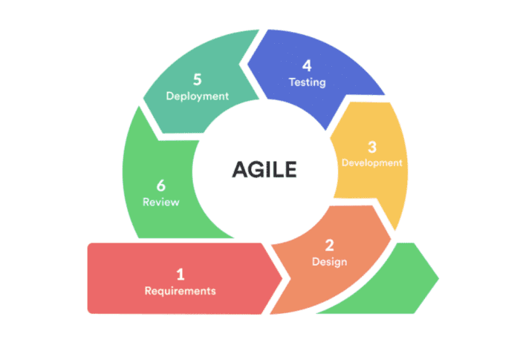
Methodology
Project Planning and Requirements Gathering.
Setup and Installation.
UI/UX Design
Web Development
Testing
Maintenance and Updates

Slide 6
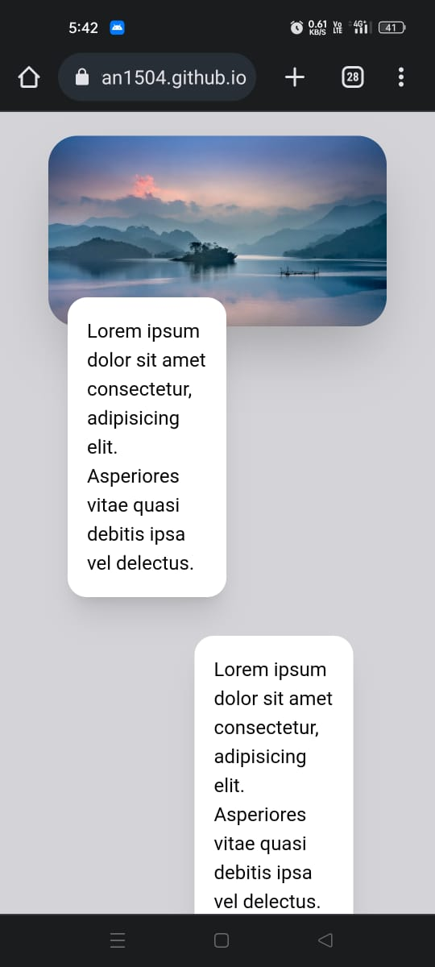
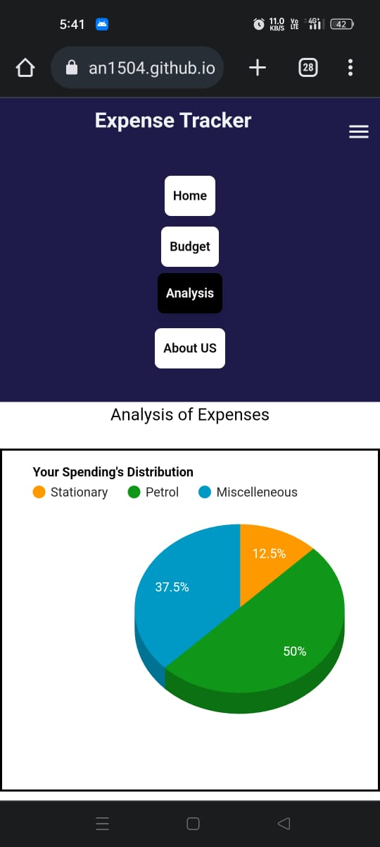
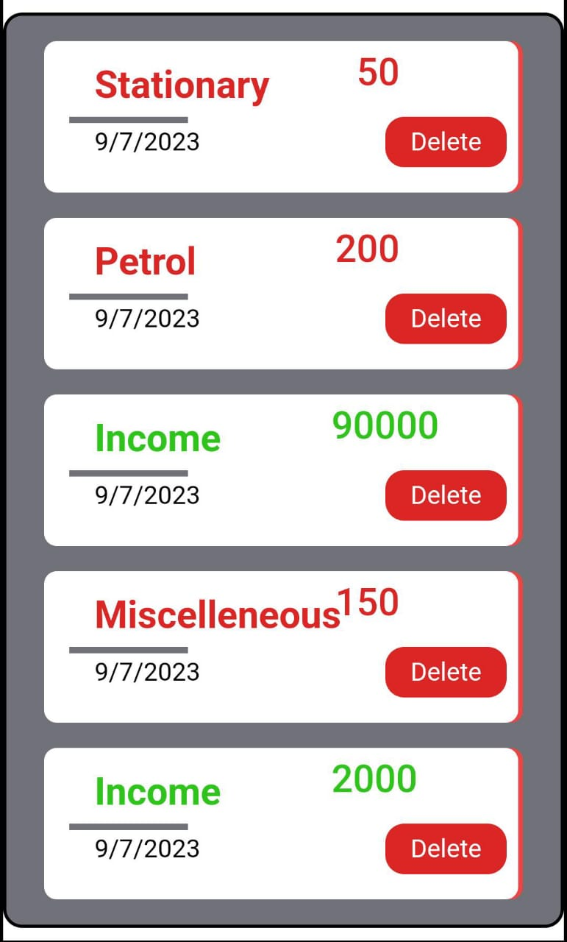
Implementation
Technical Stack
1.React JS
2.Tailwind
3.Html
4.GitHub

Slide 7
Conclusion
While doing this project I have learned a lot of things like developing a Web application using React JS, using Tailwind CSS for designing purpose. Also I learnt how to how to implement hooks in react. I have tried to make this an responsive website and user friendly.
This process of making the app taught me a lot of new things and motivated me to explore the vast domain of web development further and contribute to the field.

